Slide 1
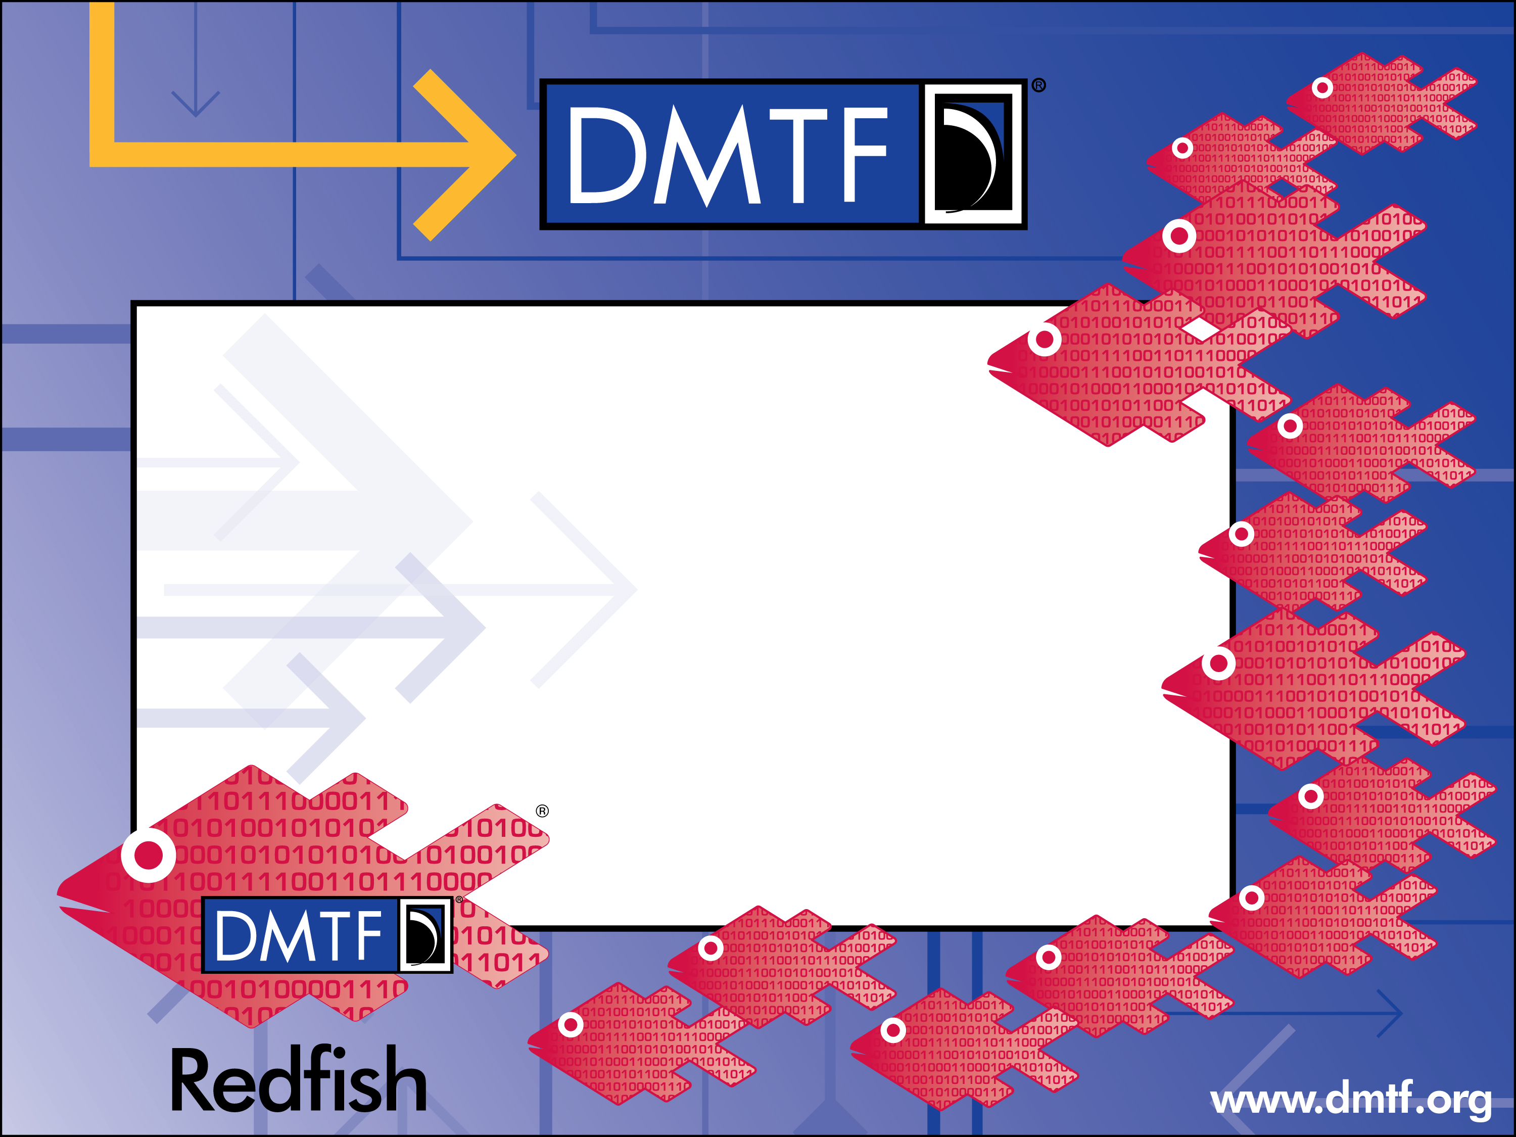
Firmware Update
John Leung
Intel Corporation

Slide 2

Agenda
Firmware Update Model
  Update Service
  Firmware Inventory
Simple Update - pull update
Multi-part HTTP Push Update
Unstructured HTTP Push Update

Slide 3
Redfish Firmware Update Model
Update Service
  The service for updating firmware
  Firmware updates are accomplished by invoking actions on the Update Service
Firmware Inventory
  Software components generally referred to as platform firmware
Software Inventory
  Software components executed in the context of a host operating system
  Such as device drivers, applications, or offload workloads
Service Root
Update Service
Firmware Inventory
Software Inventory
BMC
BIOS
NIC 1.5
SW-1

Slide 4
Firmware Package Transfer Methods
Pull update
  The Redfish service is provided a URI from which to obtain the firmware update package
  Also known as simple update
Push update
  The Redfish service is provided the firmware update package as part of the action request

Slide 5
Simple Update - pull update
Below is the fragment present in the UpdateService resource when SimpleUpdate action is supported
The 'target' property specifies the target of the HTTP POST
The SimpleUpdateActionInfo describes the parameters that can be included in the HTTP POST message
{
"Actions": {
"#UpdateService.SimpleUpdate": {
"target": "/redfish/v1/UpdateService/Actions/SimpleUpdate",
"@Redfish.ActionInfo": "/redfish/v1/UpdateService/SimpleUpdateActionInfo"
}
},

Slide 6
Parameters for Simple Update
If these parameters are in SimpleUpdateActionInfo, they can be included in the SimpleUpdate HTTP POST message
  ImageURI specifies the URI of the firmware update package
  TransferProtocol specifies the transfer protocol associated with the URI
  Targets specifies a list of resources which are to be updated with the firmware update image
  User and Password specify the credentials for accessing the firmware update package

Slide 7
Multi-part HTTP Push Update
Below is the fragment present in the UpdateService resource when the Multi-part HTTP Push Update action is supported
The 'MultipartHttpPushURI' property specifies the target of a HTTP POST
The content of the multi-part message is described below
{
"MultipartHttpPushUri": "/redfish/v1/UpdateService/update-multipart"
}
Form | Req'd | Description
Update parameters | Yes | JSON-formatted part for passing the update parameters. See "UpdateParameters" property
Update image | Yes | Binary file to use for the update. The value of the `filename` field reflects the name of the file as loaded by the client. |

Slide 8
Example: multipart HTTP push update request
POST /redfish/v1/UpdateService/update-multipart HTTP/1.1
Content-Type: multipart/form-data; boundary=---------------------------d74496d66958873e
Content-Length: <computed-length>
-----------------------------d74496d66958873e
Content-Disposition: form-data; name="UpdateParameters"
Content-Type: application/json
{}
-----------------------------d74496d66958873e
Content-Disposition: form-data; name="UpdateFile"; filename="bmc_update.bin"
Content-Type: application/octet-stream
<firmware image>
Note: the UpdateFile can contain one or more firmware images

Slide 9
Unstructured HTTP Push Update - deprecated
Below is the fragment present in the UpdateService resource when the Unstructured HTTP push update is supported
Due to the vendor-specific details of this operation, this method was deprecated in favor of multipart HTTP push update
{
"HttpPushUri": "/redfish/v1/UpdateService/update",
"HttpPushUriTargets": [],
"HttpPushUriTargetsBusy": false,
"HttpPushUriOptions": {
"HttpPushUriApplyTime": {
"ApplyTime": "Immediate",
"MaintenanceWindowStartTime": "2018-12-01T03:00:00+06:00",
"MaintenanceWindowDurationInSeconds": 600
}
},
"HttpPushUriOptionsBusy": false,
...
}

Slide 10
Thank you for watching!
Redfish Community
  Bulletin board
  http://redfishforum.com
Redfish Developer Hub
  Redfish Explorer, Hosted schema at Namespace, Educational Material
  http://redfish.dmtf.org
Redfish Forum
  Schemas, Specs, Mockups, White Papers, FAQ & more
  http://www.dmtf.org/redfish

